Slide 1
2018 Annual EMS Agency Survey
Complete Responses: 210

Slide 2
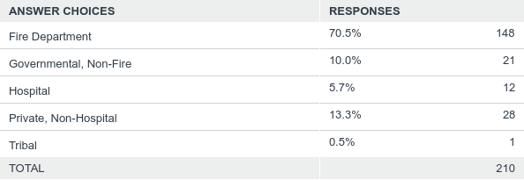
Q3: Organizational Type:
Answered: 210 Skipped: 0

Slide 3
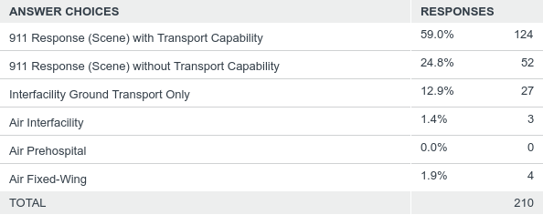
Q4: Primary Type of Service
Answered: 210 Skipped: 0

Slide 4
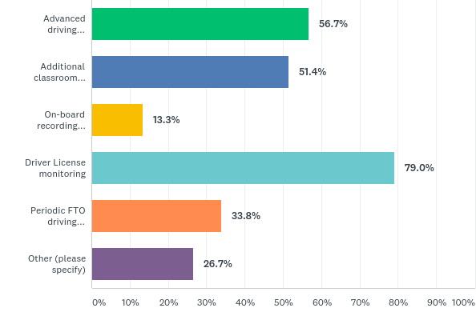
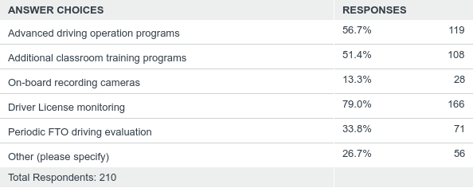
Q5: Does your EMS Agency provide additional training on safe driving or other preventative measures to promote emergency vehicle operation safety? (Check all that apply)
Answered: 210 Skipped: 0

Slide 5
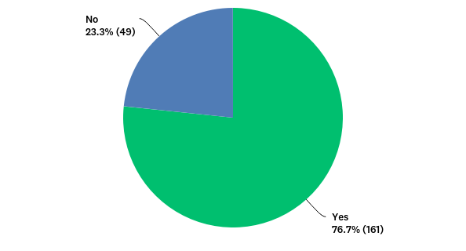
Q6: Does your EMS agency have a policy or protocol containing direction regarding (non-spinal motion restriction related) safe EMS transport for children (such as what devices should be used for various size/weight children, prohibition of any measures, training requirements, required documentation, etc.)?
Answered: 210 Skipped: 0

Slide 6
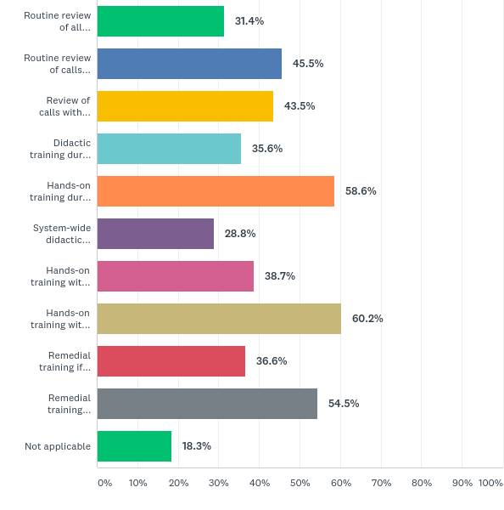
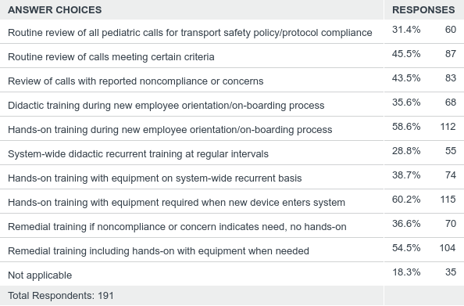
Q7: If yes, is there a quality improvement and/or system-wide recurrent training process for this policy/protocol? (Check all applicable.)
Answered: 191 Skipped: 19

Slide 7
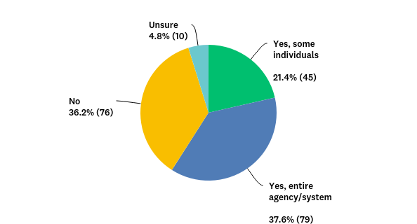
Q8: Has your agency received any pediatric related training from an outside source (such as Florida EMSC) or as part of routine internal CME within the last 2 years?
Answered: 210 Skipped: 0

Slide 8
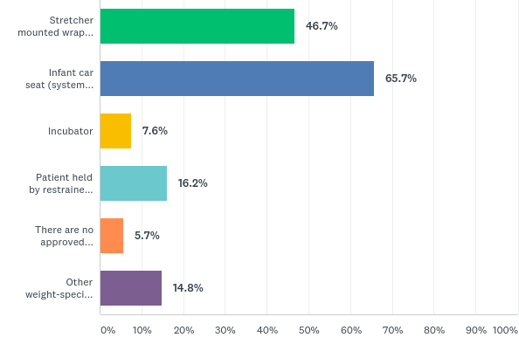
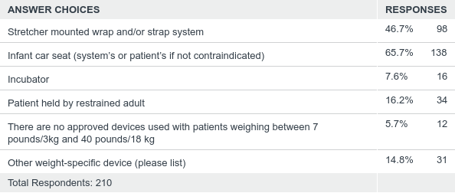
Q9: What restraint devices or practices are approved for use with patients weighing less than 7 pounds/3 kg? (Check all applicable.)
Answered: 210 Skipped: 0

Slide 9
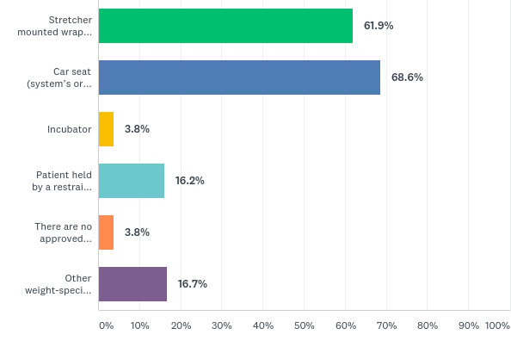
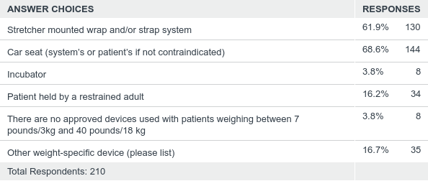
Q10: What restraint devices or practices are approved for use with patients weighing between 7 pounds/3kg and 40 pounds/18 kg? (Check all applicable.)
Answered: 210 Skipped: 0

Slide 10
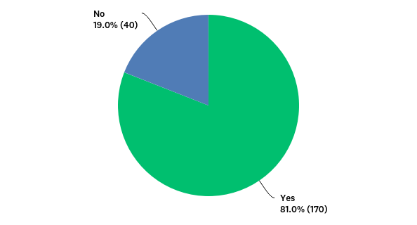
Q12: Does your agency participate in the Emergency Medical Services Tracking and Reporting System (EMSTARS)?
Answered: 210 Skipped: 0

Slide 11
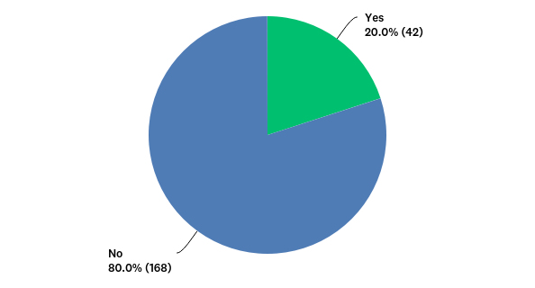
Q13: Would you like for the EMSTARS program office to contact your agency to provide assistance?
Answered: 210 Skipped: 0

Slide 12
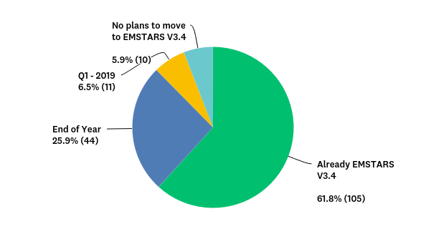
Q14: What is your agency's planned timeline for transitioning to EMSTARS V3.4?
Answered: 170 Skipped: 40

Slide 13
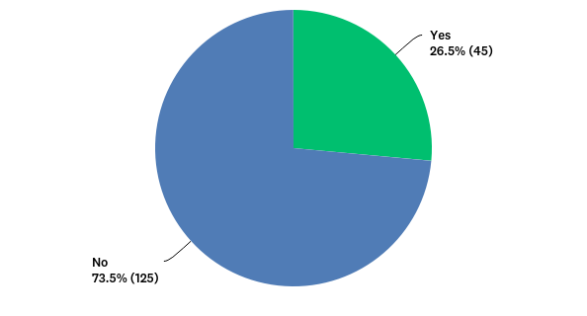
Q15: Are you a participant with Biospatial?
Answered: 170 Skipped: 40

Slide 14
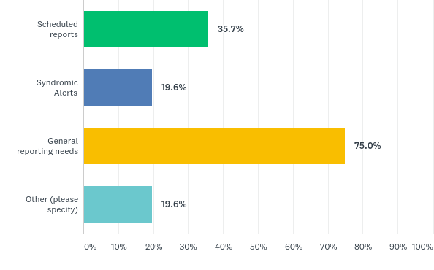
Q16: If your agency participates in Biospatial, please indicate how your uses or plans to use the system.
Answered: 56 Skipped: 154

Slide 15
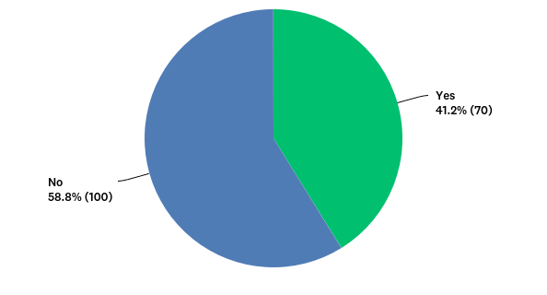
Q17: Would you like for someone from the Department of Health to contact your agency to provide Biospatial assistance?
Answered: 170 Skipped: 40

Slide 16
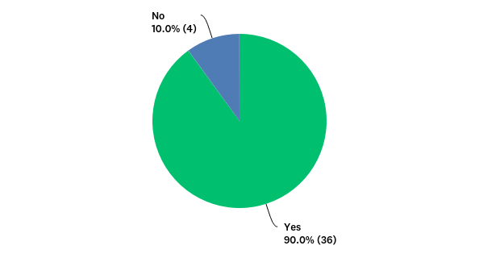
Q18: Does your agency utilize an electronic patient care reporting system to document patient care?
Answered: 40 Skipped: 170

Slide 17
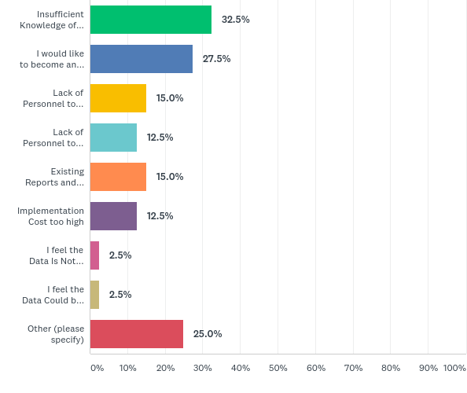
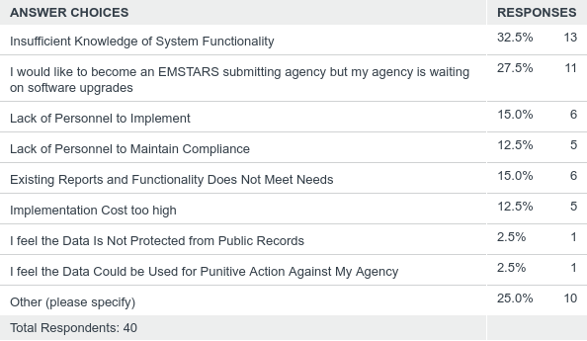
Q19: You indicated that your agency is not an EMSTARS submitting agency. Please provide the reasons why your agency has elected not to participate in EMSTARS? (select all that apply)
Answered: 40 Skipped: 170

Slide 18
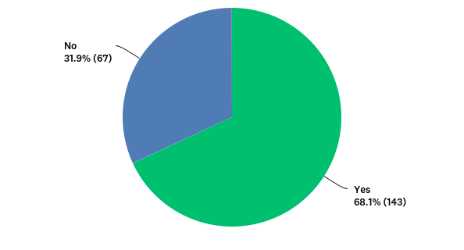
Q20: Has your EMS agency adopted plans for and trained on plans to manage an active assailant event and/or violent/hostile incidents?
Answered: 210 Skipped: 0

Slide 19
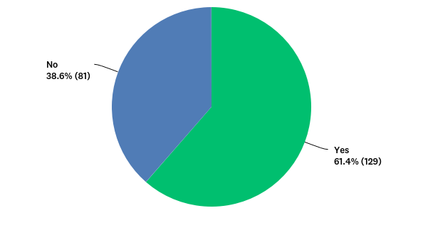
Q21: Do you feel that your EMS agency is properly equipped and supplied to appropriately manage an Active Shooter Hostile Event Response (ASHER)? As an example, trauma related supplies such as tourniquets, hemostatic dressing, chest seal and other supplies as referenced in the Hartford Consensus Compendium.
Answered: 210 Skipped: 0

Slide 20
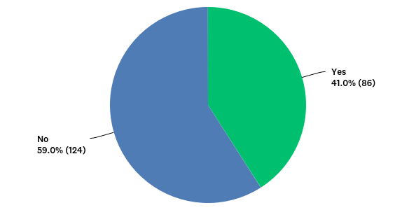
Q22: Does the EMS agency currently provide ballistic protection for the first responders?
Answered: 210 Skipped: 0

Slide 21
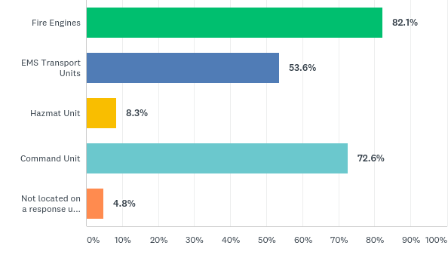
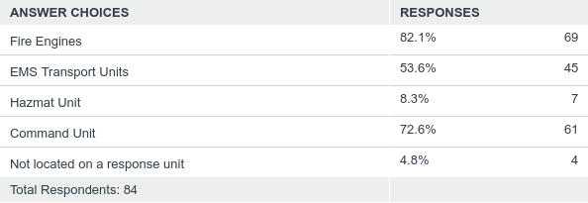
Q25: Where is the location of the ballistic protection?
Answered: 84 Skipped: 126

Slide 22
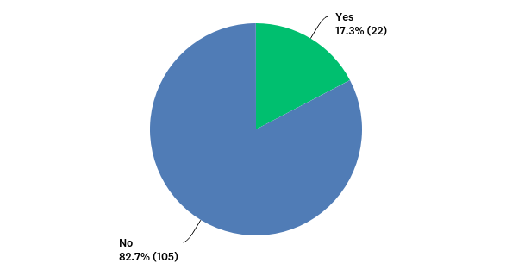
Q26: Does your EMS agency have any current plans on purchasing ballistic protection for the first responders?
Answered: 127 Skipped: 83

Slide 23
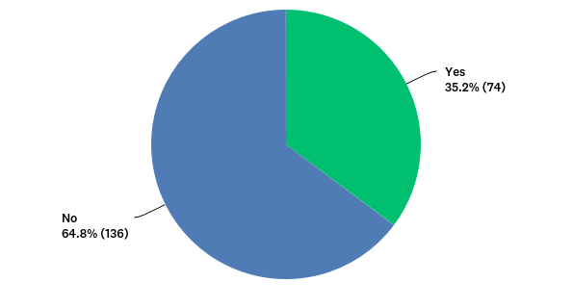
Q28: Does your EMS agency have written protocols for mass hemorrhage control at large incidents?
Answered: 210 Skipped: 0

Slide 24
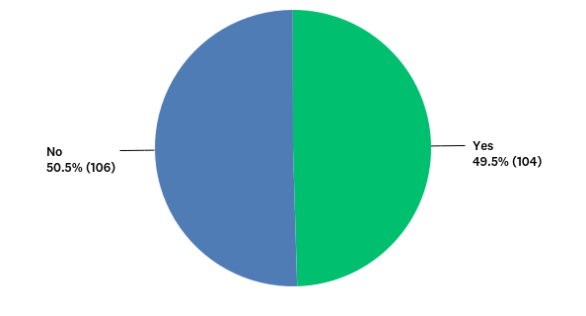
Q29: Has your EMS agency established specialized kits with supplies for mass hemorrhage control at large incidents?
Answered: 210 Skipped: 0

Slide 25
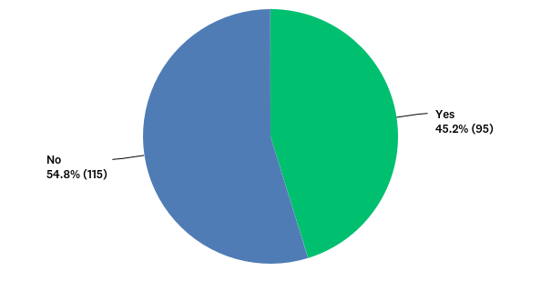
Q30: Does your EMS agency currently have policies regarding entering “warm zones” during an Active Shooter Hostile Event Response (ASHER)? As example: As part of a rescue task force.
Answered: 210 Skipped: 0

Slide 26
Q31: Does your EMS agency currently have designated entry/extraction teams that train together with law enforcement?
Answered: 210 Skipped: 0

Slide 27
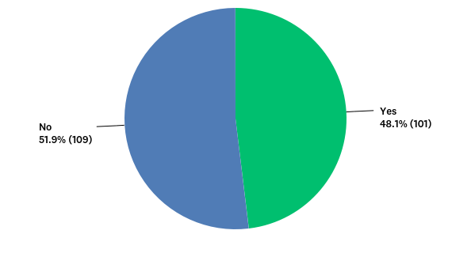
Q32: Does your agency conduct any type of hemorrhage control education to the community (i.e., Stop the Bleed)?
Answered: 210 Skipped: 0

Slide 28
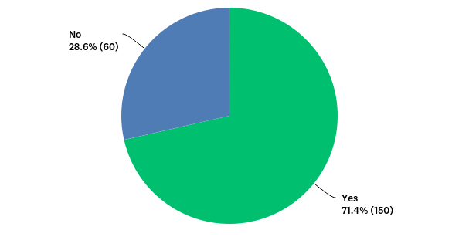
Q33: Has your EMS agency adopted plans for and trained on plans to care for highly infectious disease patients?
Answered: 210 Skipped: 0

Slide 29
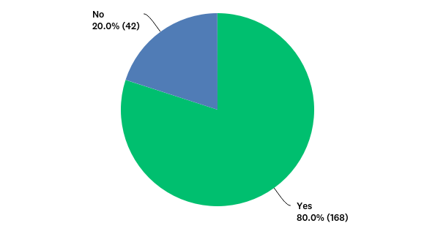
Q34: Do you feel that your EMS agency is properly equipped and supplied with materials to appropriately care for highly infectious disease patients? As example: PPE and respiratory protection
Answered: 210 Skipped: 0

Slide 30
Q35: Has your EMS agency participated in CBRNE exercises and/or training in the past year?
Answered: 210 Skipped: 0

Slide 31
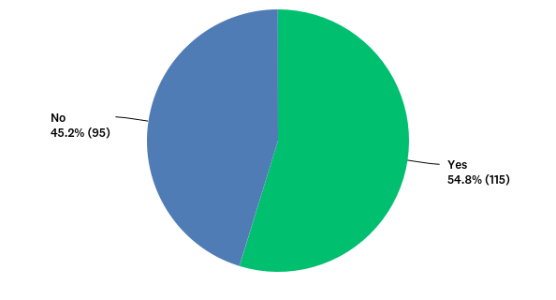
Q36: Does your EMS agency participate with a health care coalition?
Answered: 210 Skipped: 0

Slide 32
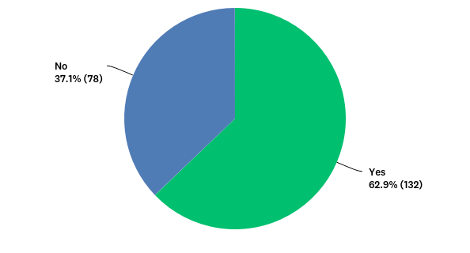
Q37: Does your EMS agency participate with local DOH Health Department meetings/committees?
Answered: 210 Skipped: 0

Slide 33
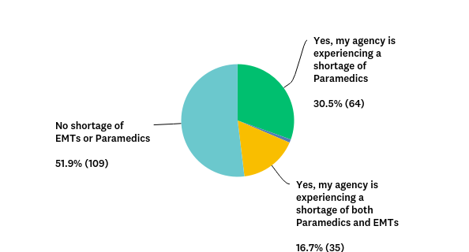
Q38: Is your agency currently experiencing a shortage of EMTs or Paramedics?
Answered: 210 Skipped: 0

Slide 34
Q39: Please indicate your agency's anticipated turnover percentage rate for EMTs and Paramedics in the next calendar year.
Answered: 210 Skipped: 0

Slide 35
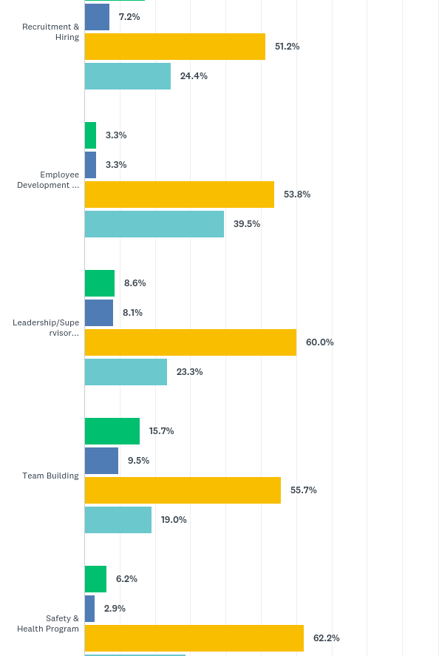
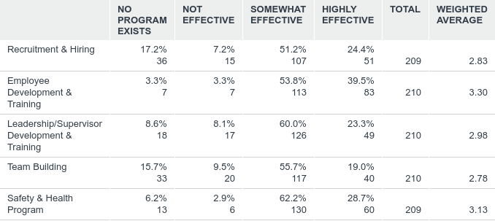
Q40: How effective are the following programs in your agency?
Answered: 210 Skipped: 0

Slide 36
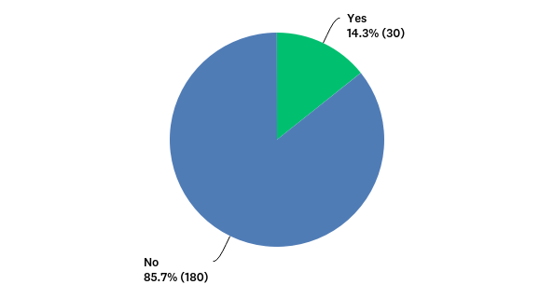
Q41: Does your agency regularly benchmark any human resource practices against other agencies?
Answered: 210 Skipped: 0

Slide 37
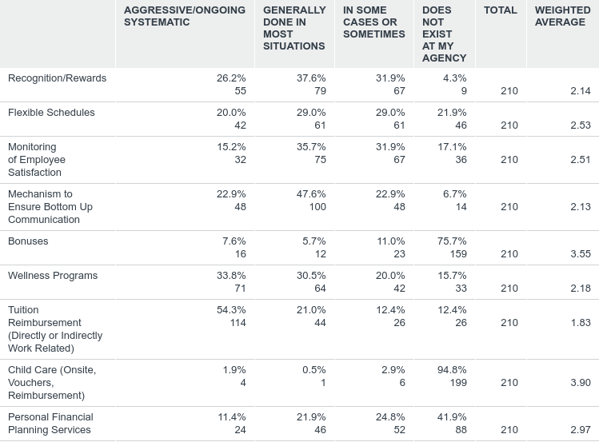
Q42: Please indicate and rate the following employee morale & retention strategies that may be present at your agency
Answered: 210 Skipped: 0

Slide 38
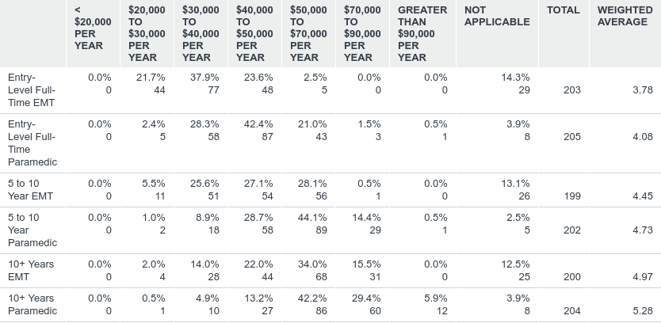
Q43: Please provide an estimate of the annual salary for the following positions
Answered: 206 Skipped: 4

Slide 39
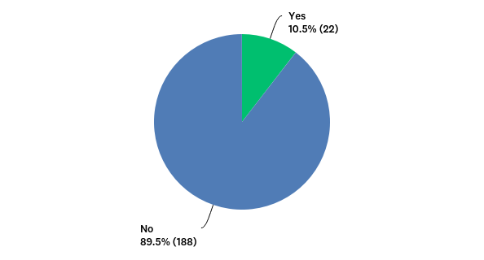
Q45: Does your EMS Agency currently conduct any type of Mobile Integrated Health Community Paramedicine (MIH-CP) program?Mobile Integrated Health Community Paramedicine (MIH-CP): The provision of healthcare using patient-centered, mobile resources in the out-of-hospital environment. MIH-CP is provided by a wide array of healthcare entities and practitioners that are administratively or clinically integrated with EMS, healthcare, and public health entities.
Answered: 210 Skipped: 0

Slide 40
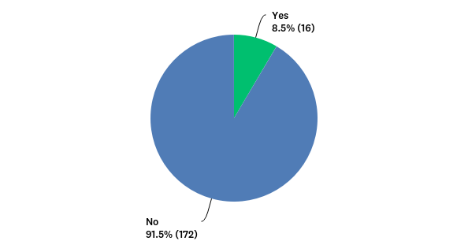
Q46: Is your agency planning to start a MIH-CP program in the next 12 months?
Answered: 188 Skipped: 22

Slide 41
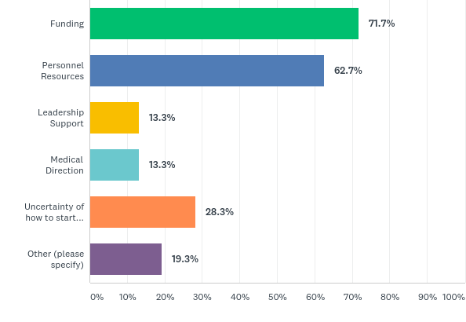
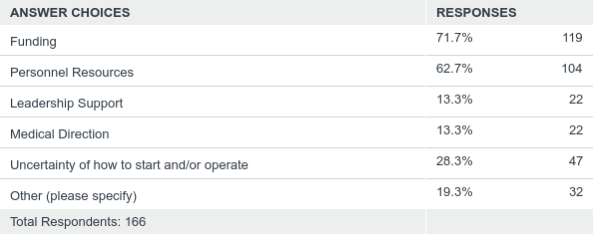
Q47: If not, please indicate the primary barriers to your agency having a MIH-CP program (check all that apply):
Answered: 166 Skipped: 44

Slide 42
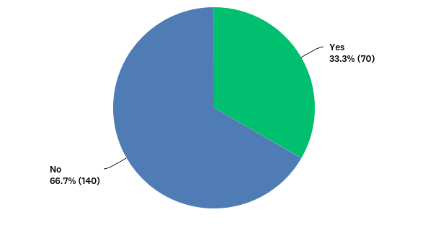
Q48: Does your EMS agency conduct or participate in any type of community focused fall prevention programs?
Answered: 210 Skipped: 0

Slide 43
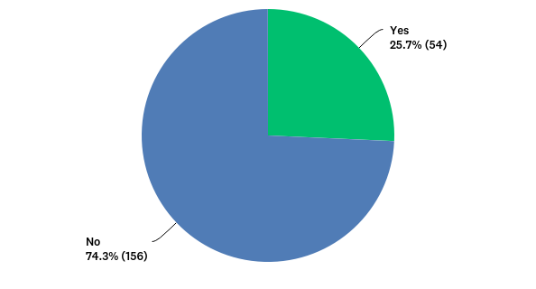
Q49: Does your EMS agency conduct or participate in any type of community focused opioid use and/or naloxone awareness programs?
Answered: 210 Skipped: 0

Slide 44
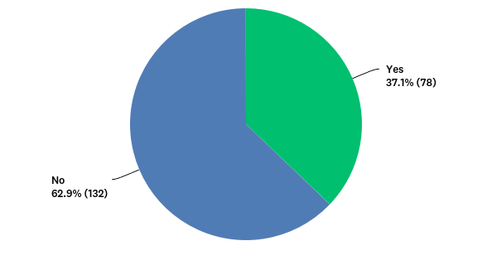
Q50: Does your EMS agency conduct or participate in any type safety programs that are sponsored by or recommended by the Department of Transportation?
Answered: 210 Skipped: 0

Slide 45
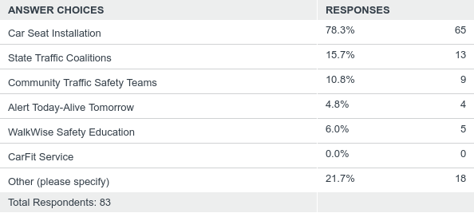
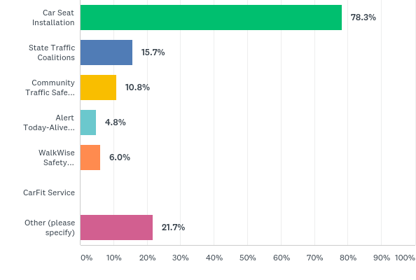
Q51: If yes, what type of safety programs that are sponsored by or recommended by the Department of Transportation does your agency conduct?
Answered: 83 Skipped: 127

Slide 46
Q52: Does your EMS agency conduct or participate in any type of community focused drowning prevention programs?
Answered: 210 Skipped: 0

Slide 47
Q53: If yes, what type of community focused drowning prevention program does your agency conduct?
Answered: 57 Skipped: 153

Slide 48
Q54: Does your EMS agency conduct or participate in any type of community focused program to reduce infant mortality?
Answered: 210 Skipped: 0

Slide 49
Q55: If yes, please select a program (check all that apply):
Answered: 41 Skipped: 169

Slide 50
Q56: If no, please outline the primary barriers in presenting these programs (check all that apply):
Answered: 162 Skipped: 48

Slide 51
Q57: Does your EMS agency conduct or participate in any community CPR programs?
Answered: 210 Skipped: 0

Slide 52
Q58: Does your EMS agency conduct or participate in any type of community awareness cardiovascular health and wellness programs to the public?
Answered: 210 Skipped: 0

Slide 53
Q59: If yes, what type of cardiovascular health and wellness programs does your agency participate in or conduct?
Answered: 85 Skipped: 125

Slide 54
Q60: Does your EMS agency conduct any type of community focused diabetes prevention and/or management programs?
Answered: 210 Skipped: 0

Slide 55
Q61: If yes, what type of community focused diabetes programs does your agency conduct?
Answered: 17 Skipped: 193

Slide 56
Q62: Does your EMS agency conduct or participate in any type of community awareness program to reduce the prevalence of HIV?
Answered: 210 Skipped: 0

Slide 57
Q63: Does your EMS agency conduct or participate in any type program to reduce the number of adult low acuity ED visits?
Answered: 210 Skipped: 0

Slide 58
Q64: Does your EMS agency have protocols that actively refer children and adults for early intervention and treatment of mental health disorders ?
Answered: 210 Skipped: 0

Slide 59
Q65: Does your EMS agency have an established immunization program for the public?
Answered: 210 Skipped: 0

Slide 60
Q66: Does your EMS agency have an established memorandum of understanding (MOU) with a county health department to provide health and wellness programs?
Answered: 210 Skipped: 0

Slide 61
Q67: Does your community paramedicine program address the following topics? (Check all that apply):
Answered: 37 Skipped: 173

Slide 62
Q69: What primary radio communications system does your EMS agency utilize?
Answered: 210 Skipped: 0

Slide 63
Q70: Is your 800 MHz or 700 MHz trunked radio system aligned with Florida’s Project 25 ID numbering plan?
Answered: 116 Skipped: 94

